Slide 1


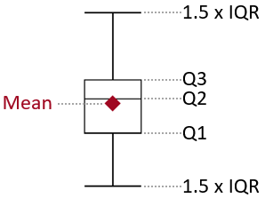
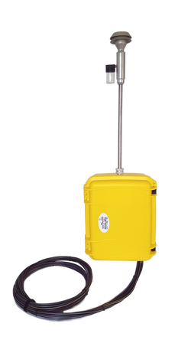
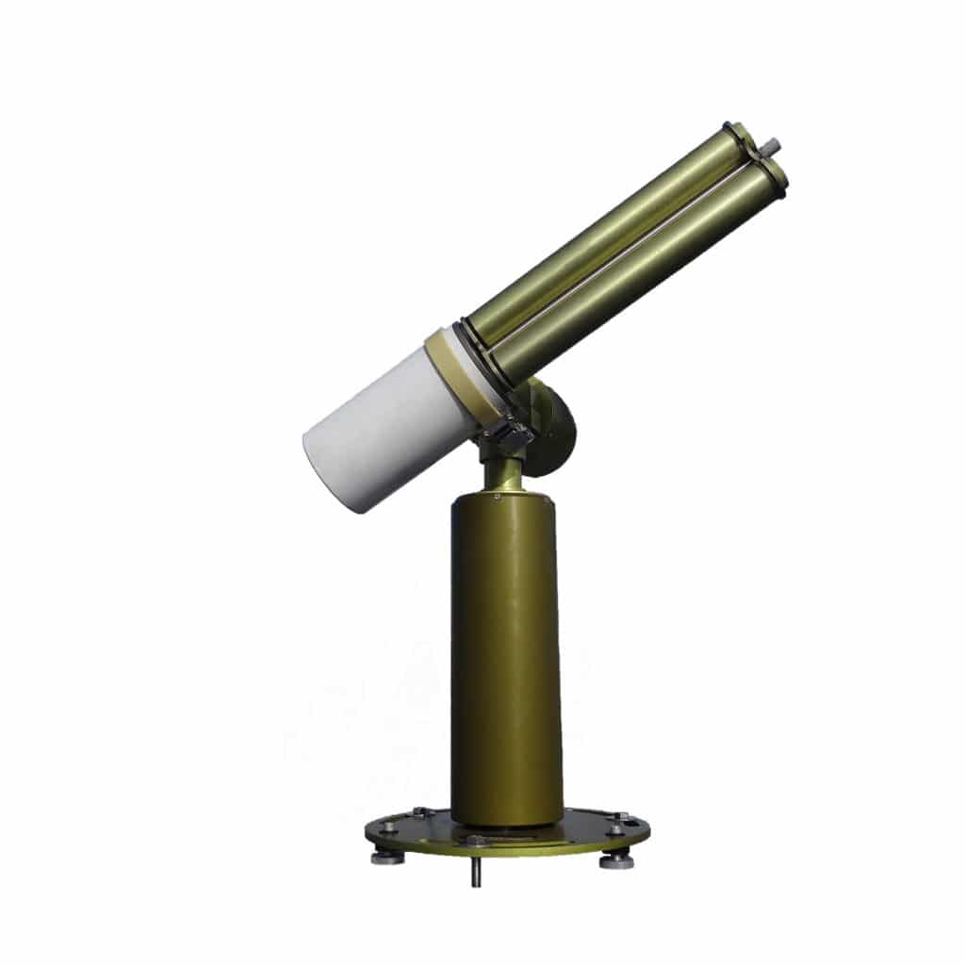

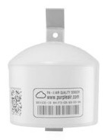

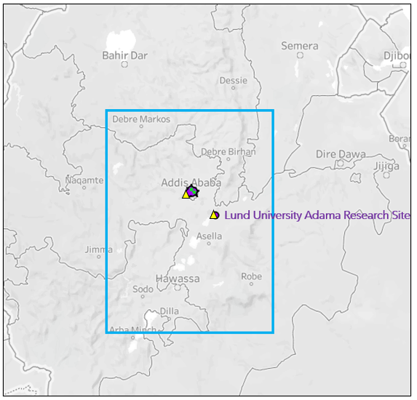
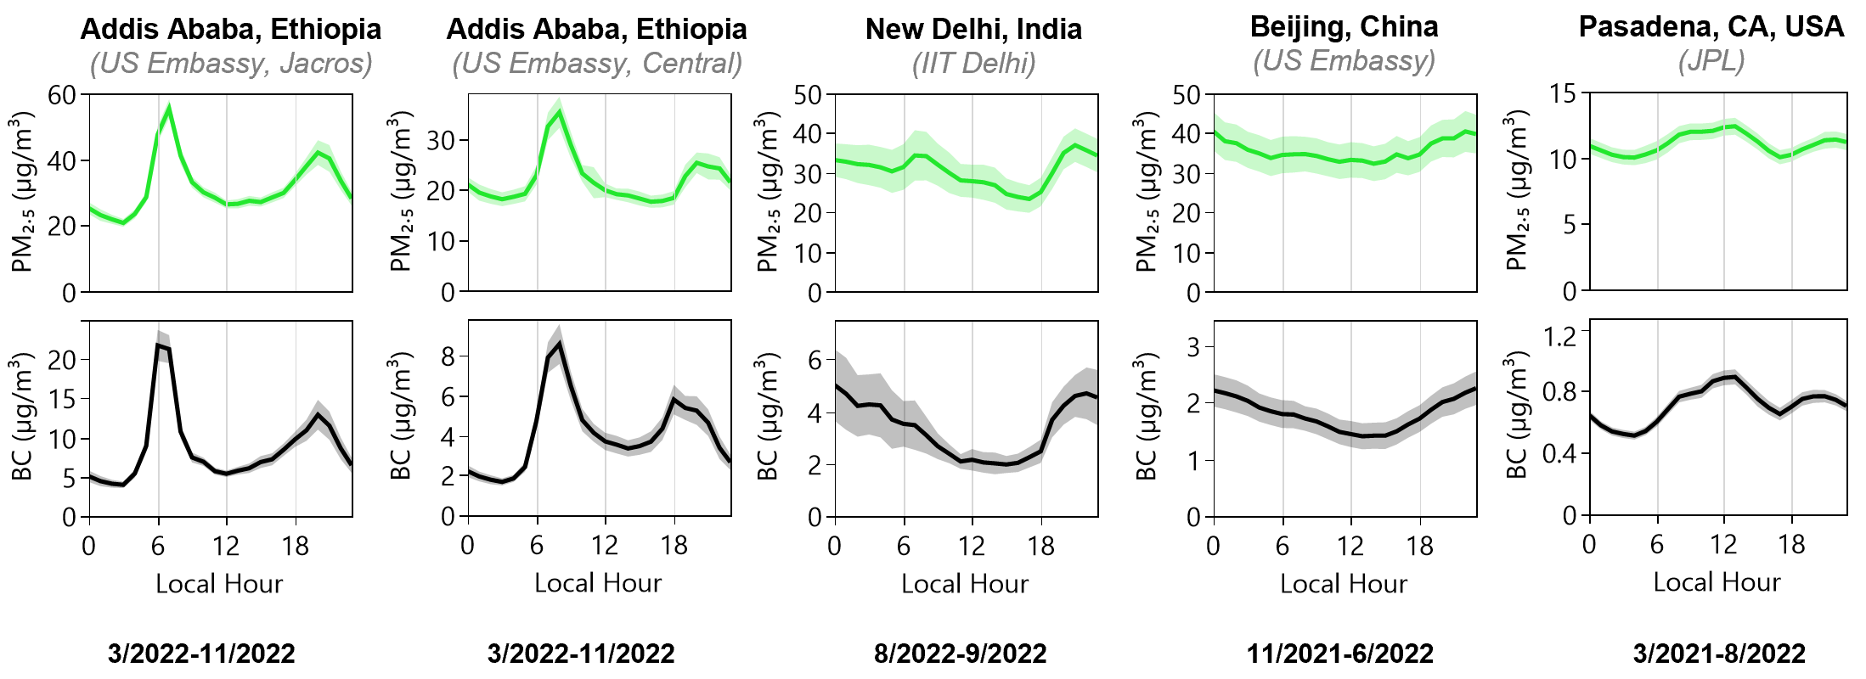
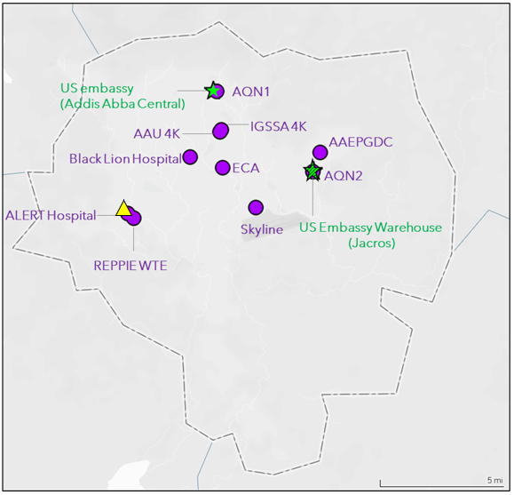
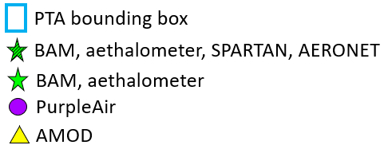
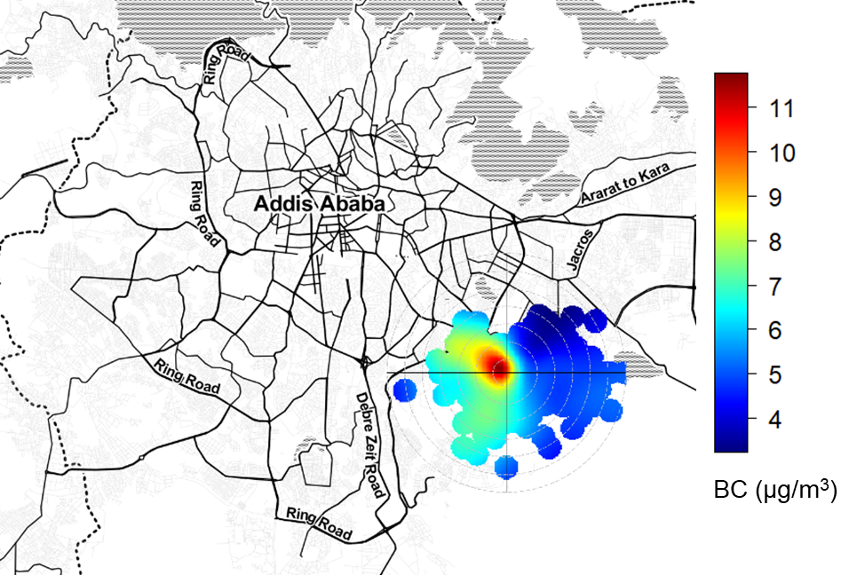
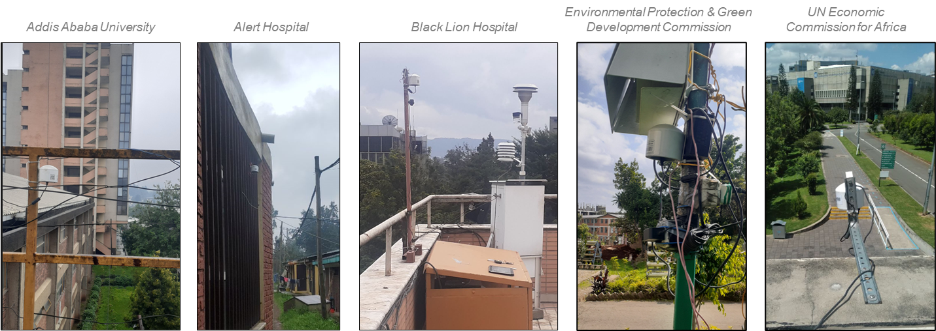
National Aeronautics
and Space Administration
In-Situ Particulate Matter Monitoring in Ethiopia for the Multi-Angle Imager for Aerosols (MAIA) Investigation: Spatial and Temporal Trends of Ambient PM_{2.5} and Black Carbon
Sina Hasheminassab,¹ David J. Diner,¹ Araya Asfaw,² Jeffrey Blair,³ Ann M. Dillner,⁴ Christina Isaxon,⁵ Yang Liu,⁶ Christian L’Orange,⁷
Tesfaye Mamo,² Randall V. Martin,⁸ Christopher Oxford,⁸ Jeremy A. Sarnat,⁶ Brenna Walsh⁸
¹Jet Propulsion Laboratory, California Institute of Technology, Pasadena, CA, ²Addis Ababa University, Addis Ababa, Ethiopia, ³AethLabs, San Francisco, CA,
⁴University of California, Davis, CA, ⁵Lund University, Lund, Sweden, ⁶Emory University, Atlanta, GA, ⁷Colorado State University, Fort Collins, CO, ⁸Washington University, St. Louis, MO
In 2016, NASA selected the Multi-Angle Imager for Aerosols (MAIA) satellite investigation to study the health impacts of exposure to ambient particulate matter (PM) and its chemical constituents.
A set of 11 Primary Target Areas (PTAs) around the world has been selected for conducting the MAIA investigation.
Fabrication of the MAIA instrument was completed in October 2022 and its launch is anticipated to occur in 2024 with a nominal 3-year mission duration.
The MAIA satellite instrument will collect targeted measurements of aerosol microphysical properties.
Satellite retrievals will be integrated with measurements from a network of ground-based PM monitors and outputs of a chemical transport model to generate daily maps of near-surface total PM₁₀, total PM_{2.5}, and speciated PM_{2.5} (sulfate, nitrate, organic carbon, elemental carbon, and dust) mass concentrations at 1-km spatial resolution.
One of the MAIA PTAs is in Ethiopia, covering Addis Ababa and vicinity (a region that is approximately 360 by 480 km).
In-Situ Air Quality Monitors & Sampling Sites
Air Monitoring Results
Air Monitoring Results
In-Situ PM Monitors in Ethiopia
Calibration of PurpleAir Sensors
Comparison of BC Levels in Ethiopia Against Other MAIA Target Areas
The US embassy operates reference beta attenuation monitors (BAM) at two locations in Addis Ababa.
The MAIA project deployed additional in-situ monitors in Addis Ababa and Adama to enhance measurements of PM_{2.5} mass and chemical composition. NASA GSFC also deployed a CIMEL sun photometer, extending AERONET into Ethiopia.
The performance of PurpleAir sensors varies by aerosol composition and environmental conditions.
Using the co-located hourly PurpleAir and BAM data at the US Embassy sites, a multiple linear regression model was developed to correct PurpleAir measurements.
Average PM_{2.5} levels in New Delhi, Beijing, and Addis Ababa are substantially higher (>2x) than in Pasadena.
Average BC concentrations vary from less than 1 µg/m³ in Pasadena to over 8 µg/m³ in Addis Ababa (US Embassy, Jacros).
 | Instrument | Quantity | Measured Parameter(s) | Measurement Type | Sampling Interval | Data Latency | Status | Measurement Start Date
 | AethLabs microAeth MA350 | 2 | Black Carbon | Continuous | 1 minute | Real-time | Operating | Mar 2022
 | PurpleAir PA-II-SD | 10 | Total PM_{2.5} | Continuous | 2 minutes | Real-time | Operating | Apr 2021
 | Colorado State University Aerosol Mass and Optical Depth (AMOD) Filter Sampler | 2 | PM_{2.5} Chemical Composition | 24-hr Integrated | Every 3rd Day | 3-6 Months | Installation in process | -----
 | AirPhoton SS5 Filter Sampler (as part of SPARTAN network) | 1 | PM_{2.5} Chemical Composition | 24-hr Integrated | Every 3rd Day | 3-6 Months | Installation in process | -----
 | CIMEL Sun Photometer (as part of AERONET network) | 1 | Aerosol Optical Properties | Continuous | 2 minutes | Real-time | Operating | Oct 2022
1
2
3
4
5
1
2
3
4
5
Spatial and Temporal Trends of Ambient PM_{2.5}
Monitoring Sites
Ambient PM_{2.5} shows a strong spatial gradient across Addis Ababa.
The central and western parts of Addis Ababa have the highest PM_{2.5} levels, while the northern area has the lowest.
Source strength/activity and meteorology drive the diurnal patterns of PM_{2.5} and BC
Highest PM_{2.5} levels were measured between June and September.
Previous source apportionment studies reported enhanced contributions from biomass burning and vehicular sources during this period.
Directionality of BC
The US Embassy Jacros site is 4km from the Addis Ababa Bole International Airport, where wind measurements are available.
Assuming that the BC levels at Jacros and the airport are comparable, a bivariate polar plot analysis was performed.
The polar plot illustrates that the highest BC levels are associated with NW winds, pointing toward the city center.
Examples of PurpleAir monitoring sites
Diurnal PM_{2.5} trends are characterized by a distinct monitoring rush hour peak in all months, suggesting emissions from vehicular sources.
A second, larger peak appears at night, between June and September, likely due to increased emissions from biomass burning for cooking and/or heating purposes.
Acknowledgments
This research was carried out, in part, at the Jet Propulsion Laboratory, California Institute of Technology, under contract with NASA.
The US Agency for International Development (USAID) has provided funding to supplement MAIA's activities in Africa.
The US Department of State (DOS) facilitates shipments of equipment and consumables. DOS also hosts some of the air monitoring equipment at the embassy sites.
National Aeronautics and Space Administration
Jet Propulsion Laboratory
California Institute of Technology
Pasadena, California
www.nasa.gov
Reference herein to any specific commercial product, process, or service by trade name, trademark, manufacturer, or otherwise, does not constitute or imply its endorsement by the United States Government or the Jet Propulsion Laboratory, California Institute of Technology.
© 2022. Government sponsorship acknowledged.

