Slide 1
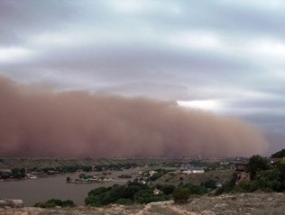
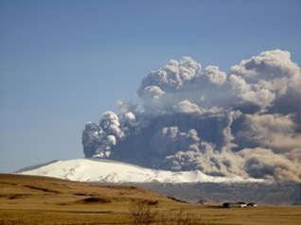
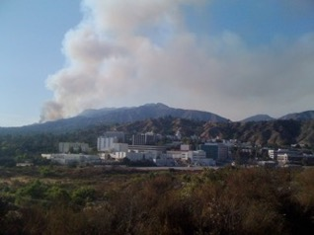
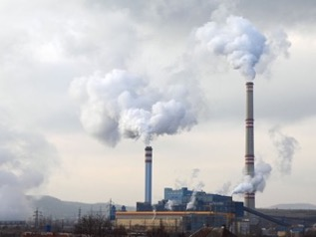
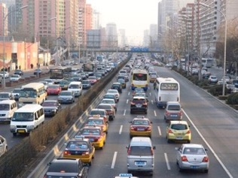


NASA’s Multi-Angle Imager for Aerosols (MAIA) Investigation in Africa: An Integrated Satellite and Surface Monitoring Approach for Mapping Speciated Particulate Matter Air Pollution
Sina Hasheminassab,¹ David J. Diner,¹ Araya Asfaw,² Jeffrey Blair,³
Rebecca Garland,⁴ Christina Isaxon,⁵ Juanette John,⁶ Kristy Langerman,⁷ Yang Liu,⁸ Christian L’Orange,⁹
Tesfaye Mamo,² Randall V. Martin,¹⁰ Lotta Mayana,¹¹ Mogesh Naidoo,⁶ Christopher Oxford¹⁰
¹Jet Propulsion Laboratory, California Institute of Technology, Pasadena, CA; ²Addis Ababa University, Addis Ababa, Ethiopia; ³AethLabs, San Francisco, CA; ⁴University of Pretoria, Pretoria, South Africa; ⁵Lund University, Lund, Sweden; ⁶Council for Scientific and Industrial Research, Pretoria, South Africa; ⁷University of Johannesburg, Johannesburg, South Africa; ⁸Emory University, Atlanta, GA; ⁹Colorado State University, Fort Collins, CO; ¹⁰Washington University, St. Louis, MO; ¹¹NerdyChemists Forensic and Industrial Science, Pretoria, South Africa
18 Jan 2023
© 2022 California Institute of Technology. Government sponsorship acknowledged.

Slide 2

MAIA Earth Venture Instrument Investigation
MAIA was selected in 2016 as a NASA Earth Venture Instrument (EVI) investigation with a primary emphasis on societal benefit.
MAIA’s EVI objective is to link exposure to different PM types (mixtures of particles having different sizes, shapes, and compositions) with human health.
MAIA applies and extends current satellite-based methodologies to enable mapping of speciated PM in selected metropolitan areas around the world.
NASA and the Italian Space Agency (ASI) are partnering on the MAIA mission, with ASI contributing the host spacecraft, launch, and complementary science.
Satellite launch: ~2024
Baseline flight mission duration: 3 years

Slide 3
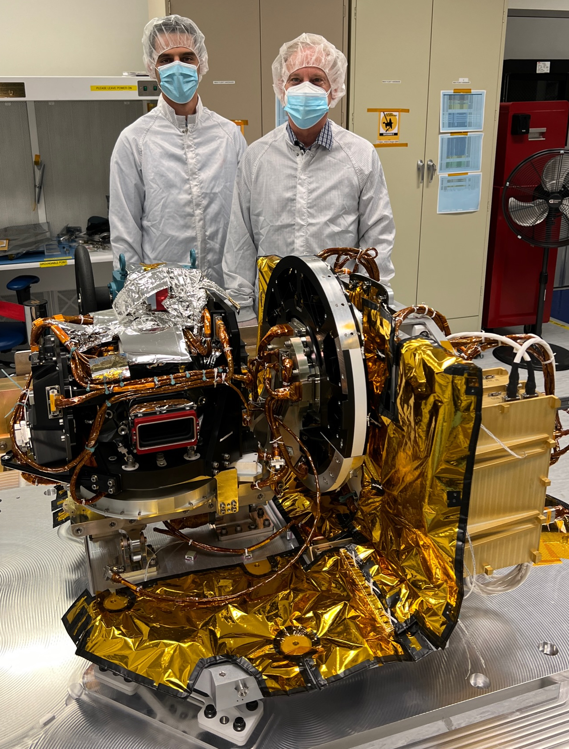
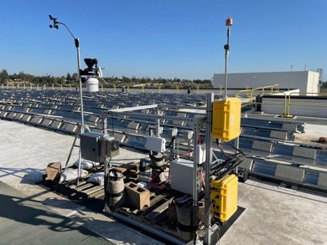
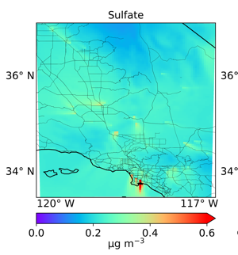


Key Elements of the MAIA-EVI Investigation
Satellite instrument | Surface monitor network | Chemical transport model | Health records
(
)
Completed in October 2022
Public products
Privacy protected
Daily concentration maps of PM₁₀, PM_{2.5}, speciated PM_{2.5} at 1-km spatial resolution
Epidemiological
studies
Birth, death, and hospitalization data

Slide 4
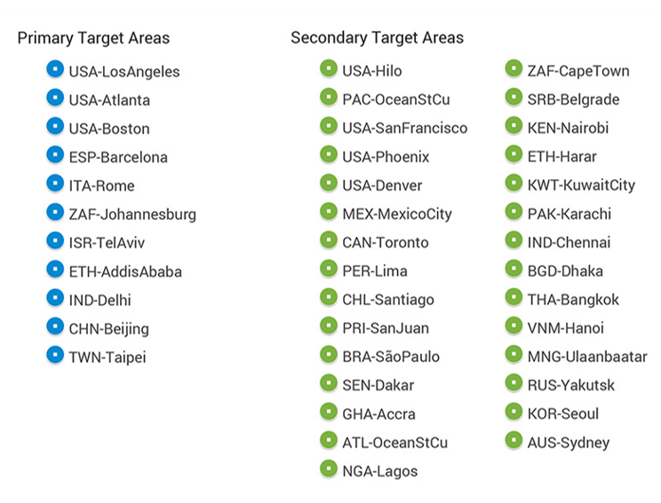
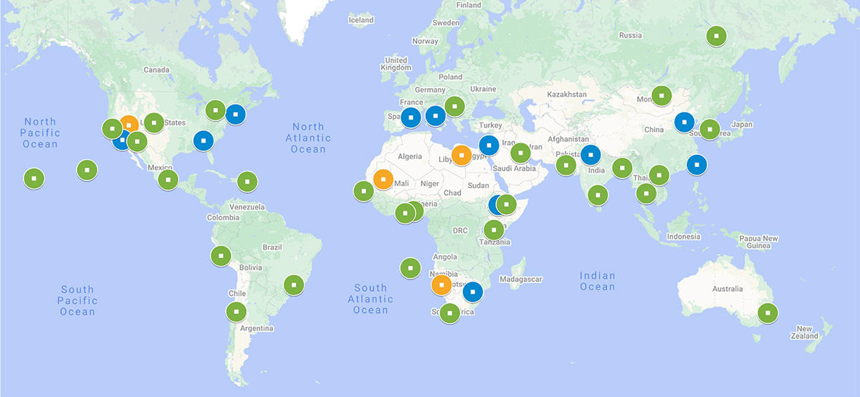
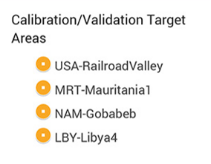
Current MAIA-EVI Target Areas
MAIA Investigation is Target Based
Target area dimensions: 360 km x 480 km
Primary Target Areas (PTAs) are chosen by the MAIA Science Team for conducting and supporting the MAIA health studies
Secondary Target Areas (STAs) are areas of interest (e.g., cities with major pollution, aerosol source regions, climatically important cloud regimes), but where health studies are not mandated

Slide 5
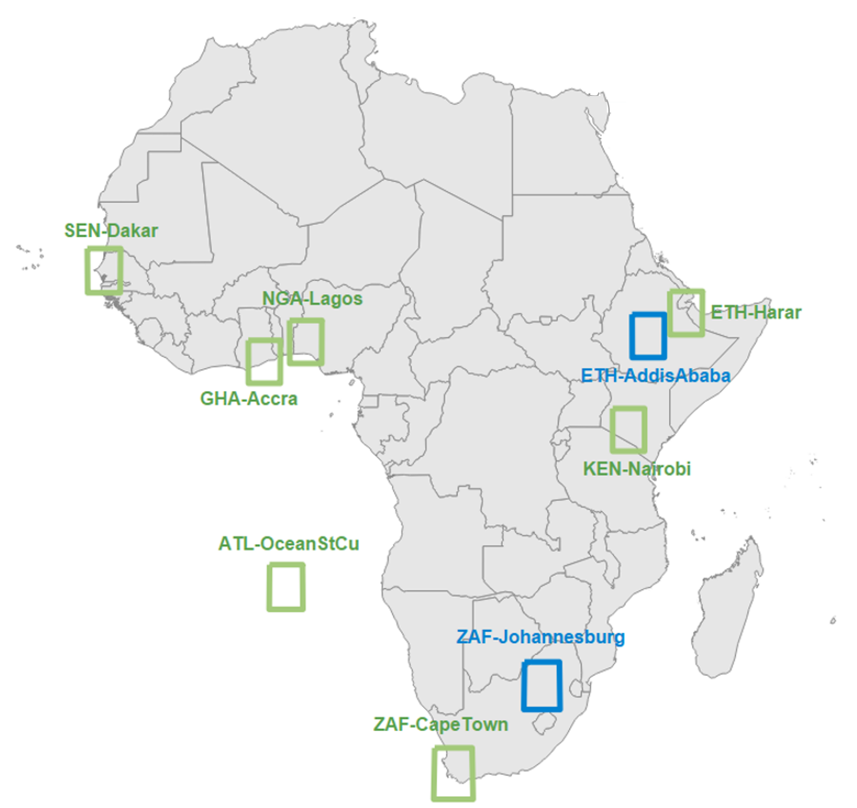
Current MAIA Target Areas in Africa
Primary Target Areas (PTAs) are chosen by the MAIA Science Team for conducting and supporting the MAIA health studies
Secondary Target Areas (STAs) are areas of interest (e.g., cities with major pollution, aerosol source regions, climatically important cloud regimes), but where health studies are not mandated

Slide 6
Current Plans for Health Studies in African PTAs
Acute | Subchronic | Chronic
Address | Postal code | Municipality
PTA | Health outcomes/exposure timescale | Source/geocoding | MAIA lead | Local investigator
ETH-AddisAbaba | Preeclampsia, low birth weight and tuberculosis, child mortality/growth/lung function/cognition (Addis Ababa) | Birth cohort through Lund University and Armauer Hansen Research Institute | M. Jerrett B. Ritz | E. Malmqvist (Lund University)
 | Respiratory morbidity, lung function, cognition (Adama) | Young children cohort through Lund University
ZAF-Johannesburg | Cause-specific mortality due to ischemic heart disease, stroke, pneumonia, COPD, diabetes | Statistics South Africa | M. Brauer | J. Wichmann (Univ. of Pretoria)

Slide 7
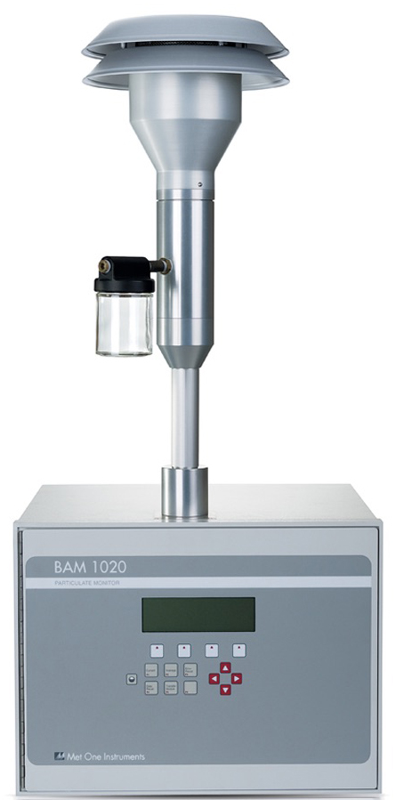
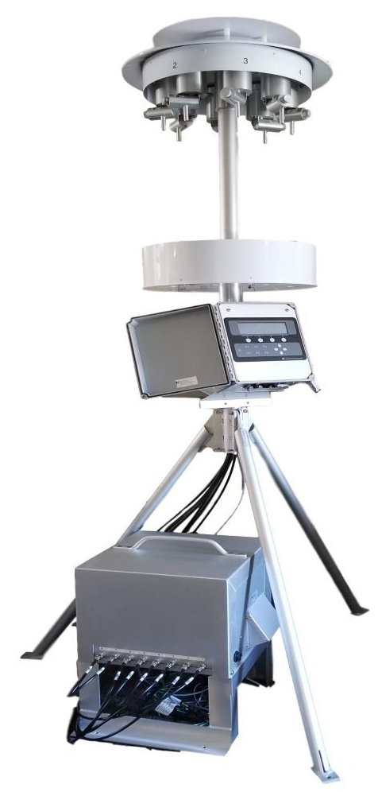
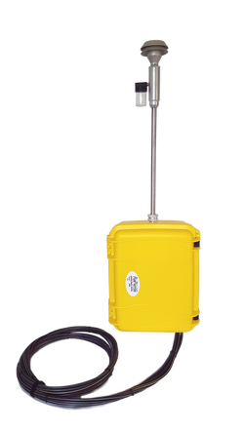
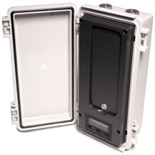
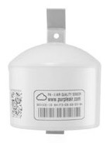

Surface PM Monitoring
Regression of retrieved aerosol properties against surface monitor (total and speciated PM) data is used to calibrate the aerosol-to-PM transformations
Where available, MAIA project collects data from existing ground-based PM monitoring networks
MAIA project is deploying additional surface PM monitors in selected target areas to augment existing monitoring networks
 | Existing monitoring networks |  | SS5-PM_{2.5} filter-based sampler | Aerosol Mass and Optical Depth (AMOD) | microAeth MA350 aethalometer | PA-II-SD
Vendor | Various vendors |  | AirPhoton (SPARTAN network) | Colorado State University | AethLabs | PurpleAir
Pollutants | PM_{2.5} speciation, total PM_{2.5}, total PM₁₀ |  | PM_{2.5} speciation | PM_{2.5} speciation | Black carbon | Total PM_{2.5}
Target areas | All target areas |  | CHN-Beijing (x1) | CHN-Beijing (x1) | CHN-Beijing (x1) | ETH-AddisAbaba (x10)
 |  |  | ETH-AddisAbaba (x1) | ETH-AddisAbaba (x2) | ETH-AddisAbaba (x2)
 |  |  | IND-Delhi (x1) | IND-Delhi (x3) | IND-Delhi (x1)
 |  |  | ISR-TelAviv (x2) | TWN-Taipei (x2) | USA-Los Angeles (x1)
 |  |  | TWN-Taipei (x2) | USA-Atlanta (x1)
 |  |  | USA-Los Angeles (x1) | USA-Los Angeles (x1)
 |  |  | ZAF-Johannesburg (x2) | ZAF-Johannesburg (x1)
Although launch of the satellite instrument is not expected until 2024, surface PM measurements are being collected prior to launch to establish baseline pollution levels and exercise MAIA’s ground data processing software.

Slide 8
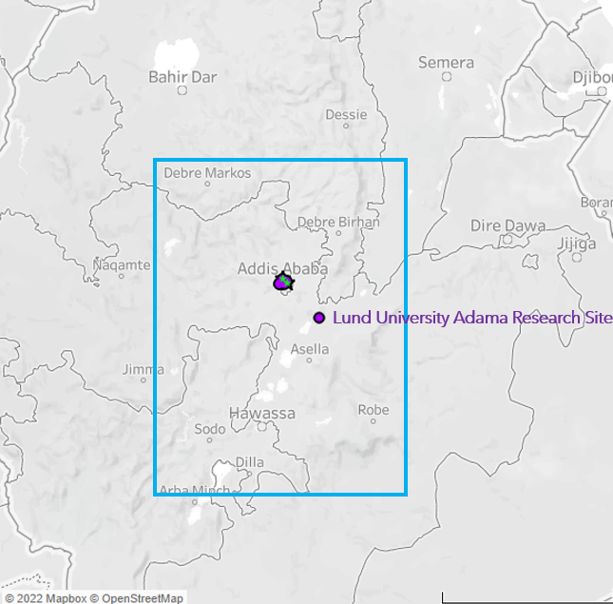
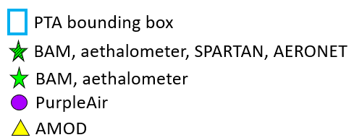
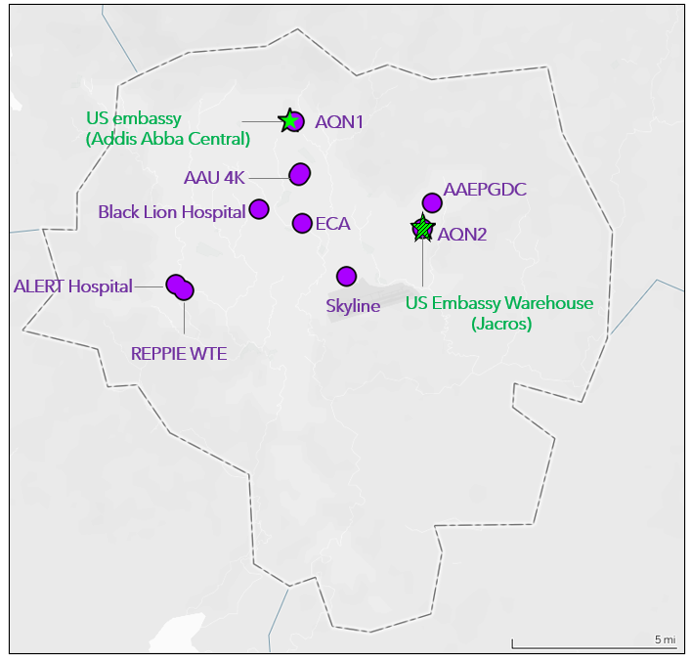
Surface PM Monitoring Sites in Ethiopia PTA

Slide 9
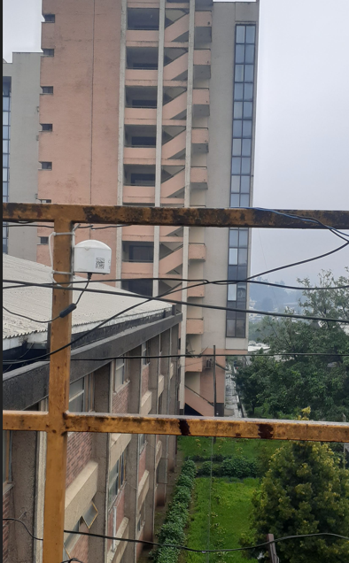
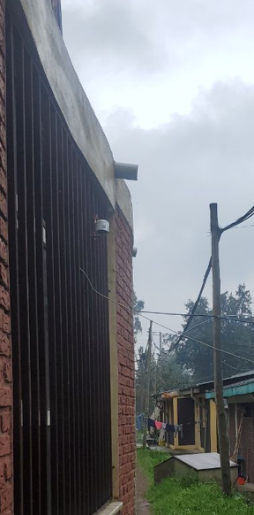
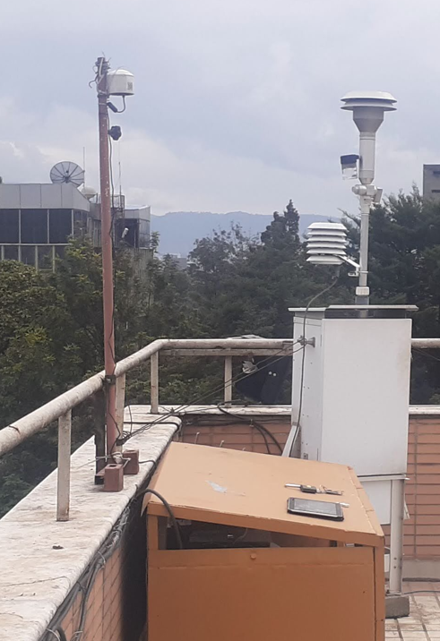
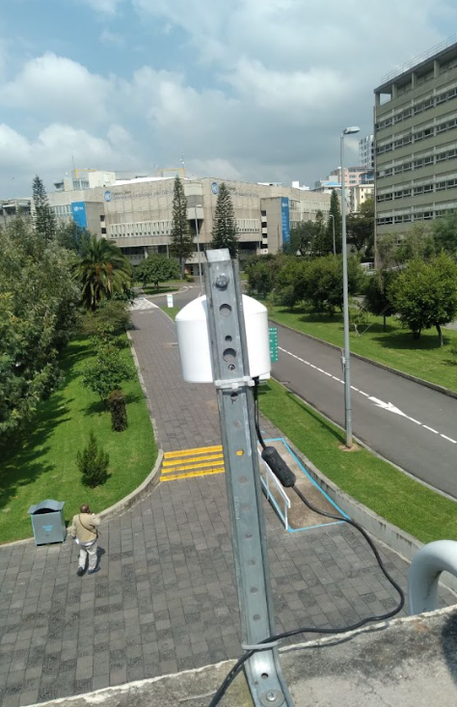
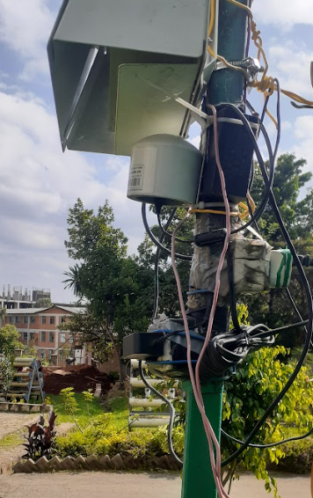
Surface PM Monitoring Sites in Ethiopia PTA
PurpleAir PA-II-SD
UN Economic Commission for Africa
Environmental Protection & Green Development Commission
Addis Ababa University
Alert Hospital
Black Lion Hospital
Note: These photos are examples of the operational sites; they do not depict all monitoring sites.

Slide 10
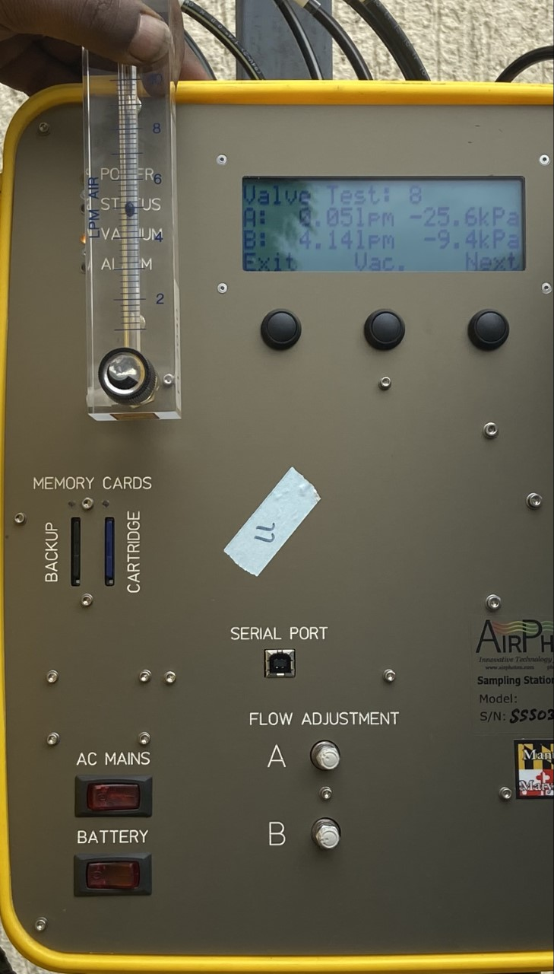
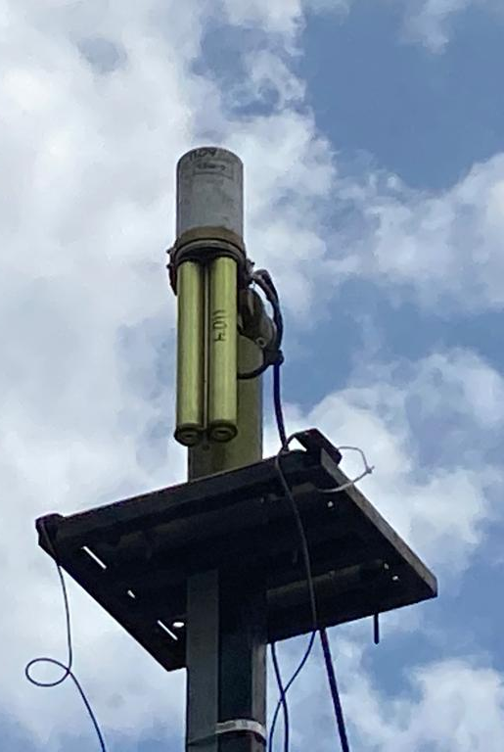
Surface PM Monitoring Sites in Ethiopia PTA
AirPhoton SS5 PM_{2.5} Sampler
(SPARTAN Network)
CIMEL Sun Photometer
(AERONET Network)
US Embassy Warehouse (Jacros)
US Embassy Warehouse (Jacros)

Slide 11
Preliminary Surface PM Monitoring Results in Ethiopia PTA
Average PM_{2.5} Measured by PA Sensors Across Addis Ababa
Monthly Average PM_{2.5} Measured by PA Sensors Across Addis Ababa
PM_{2.5} levels show strong spatial and temporal variations in Addis Ababa

Slide 12
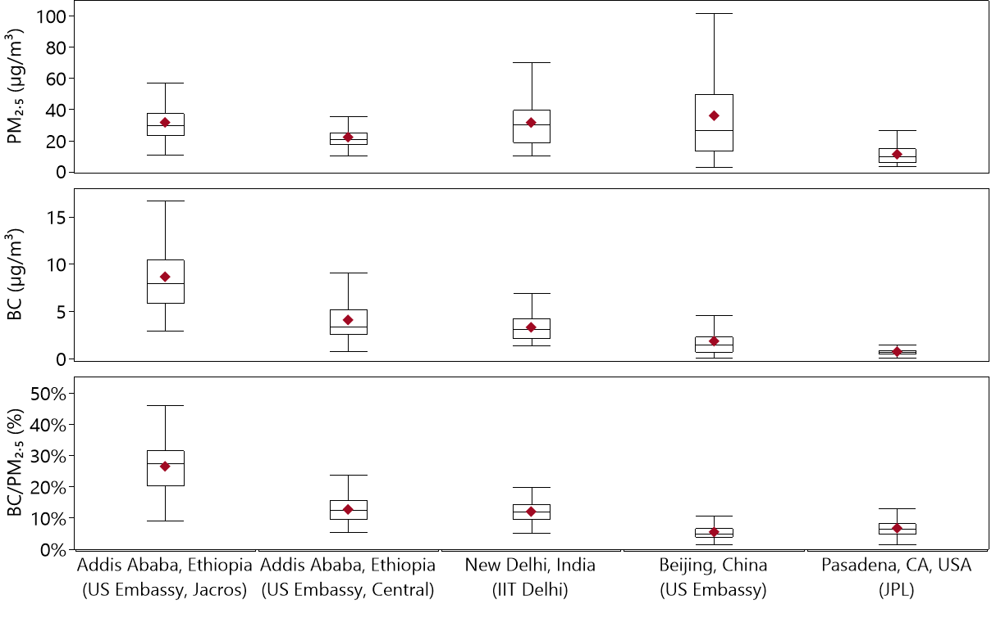
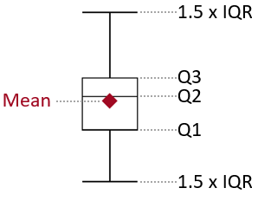
Preliminary Surface PM Monitoring Results in Ethiopia PTA
Daily Averaged PM_{2.5} and Black Carbon
3/2022-11/2022 | 3/2022-11/2022 | 8/2022-9/2022 | 11/2021-6/2022 | 3/2021-8/2022
Average PM_{2.5} levels in Delhi, Beijing, and Addis Ababa are comparable, but substantially higher (>2x) than in Pasadena.
Average black carbon concentrations vary from less than 1 µg/m³ in Pasadena to over 8 µg/m³ in Addis Ababa (US Embassy, Jacros).
Black carbon makes up, on average, 6% of PM_{2.5} mass in Pasadena and Beijing, 10% in New Delhi and Addis Ababa (US embassy, Central), and over 25% in Addis Ababa (US Embassy, Jacros).

Slide 13
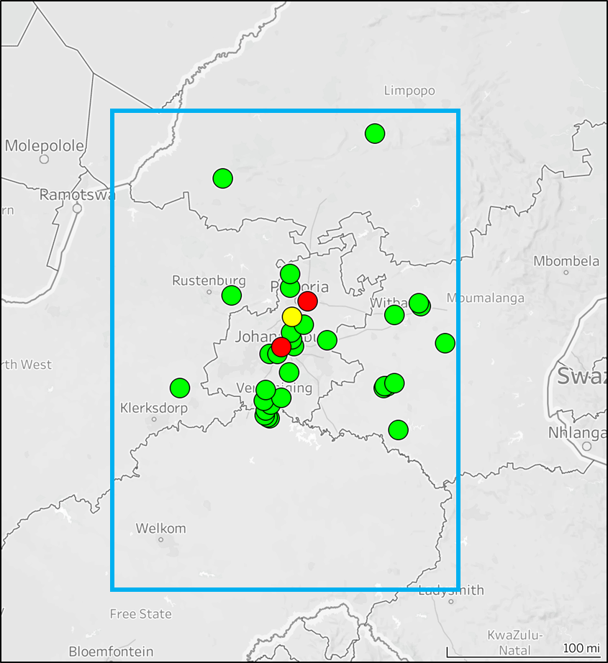
Surface PM Monitoring Sites in South Africa PTA
PTA Bounding box
SAAQIS
SPARTAN
AMOD

Slide 14
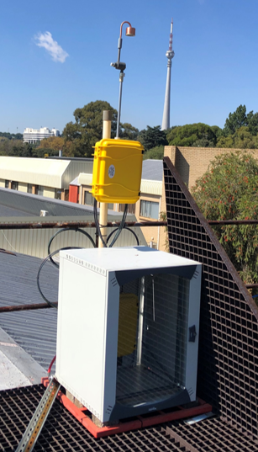
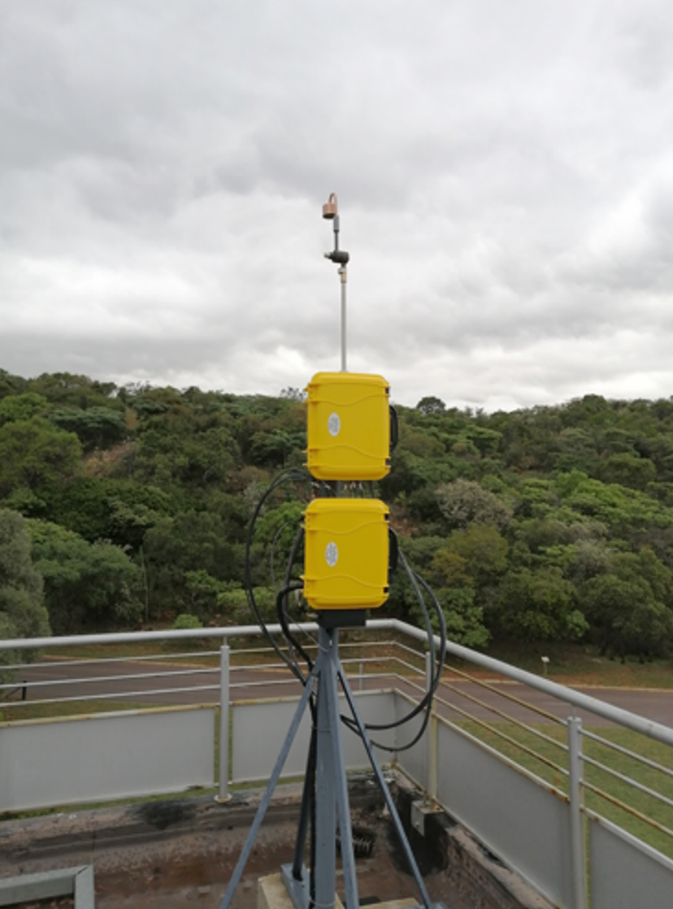
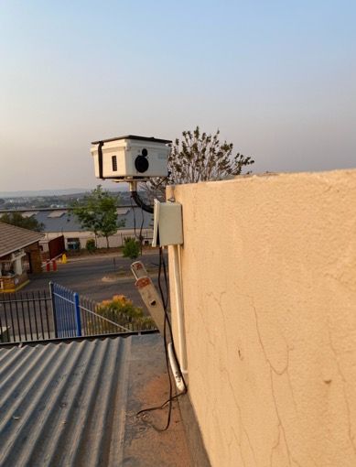
Surface PM Monitoring Sites in South Africa PTA
AirPhoton SS5 PM_{2.5} Sampler
(SPARTAN Network)
AMOD Sampler
Johannesburg
University of Johannesburg Kingsway Campus
Pretoria
Council for Scientific and Industrial Research
Thatchfield, Centurion

Slide 15
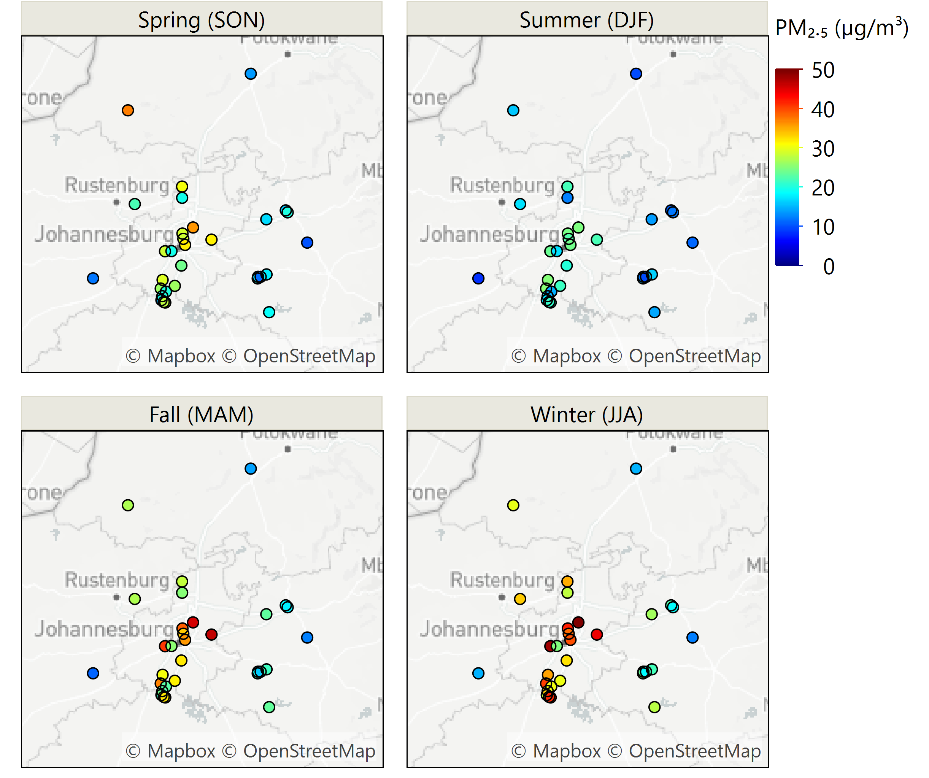
Preliminary Surface PM Monitoring Results in South Africa PTA
Seasonal Average PM_{2.5} in South Africa PTA (2021)
PM_{2.5} levels are generally higher in fall and winter due to a combination of increased emissions from sources such as biomass burning and wind-blown dust, as well as more stagnant conditions.
PM_{2.5} shows a distinct spatial gradient, with the highest levels in the densely populated Gauteng Province (Cities of Ekurhuleni, Johannesburg, Sedibeng, Tshwane) and lowest levels in smaller cities in other provinces (e.g., Mpumalanga)
Data source: SAAQIS

Slide 16
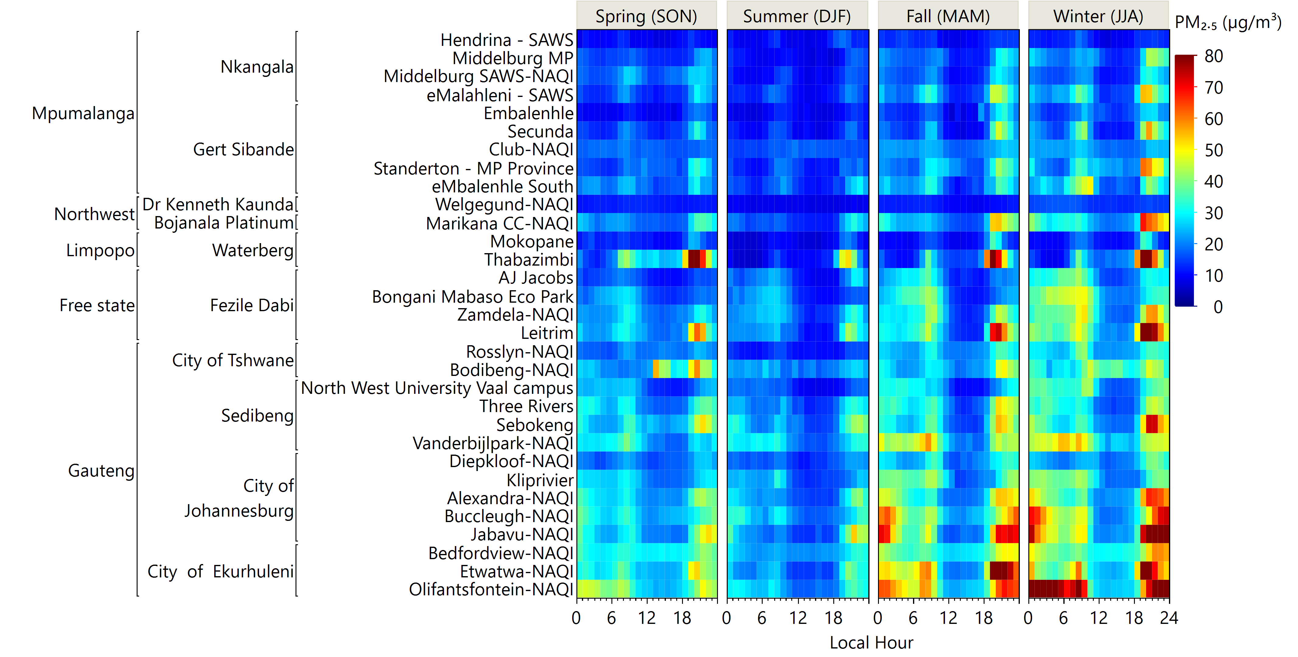
Preliminary Surface PM Monitoring Results in South Africa PTA
Average Diurnal PM_{2.5} by Site and Season in South Africa PTA (2021)
Province
City
Site
Data source: SAAQIS
All sites and cities exhibit a clear PM_{2.5} diurnal trend, with peaks in the morning (8-9am) and at night (7-9pm).
The peaks are more pronounced during the winter and fall seasons.

Slide 17
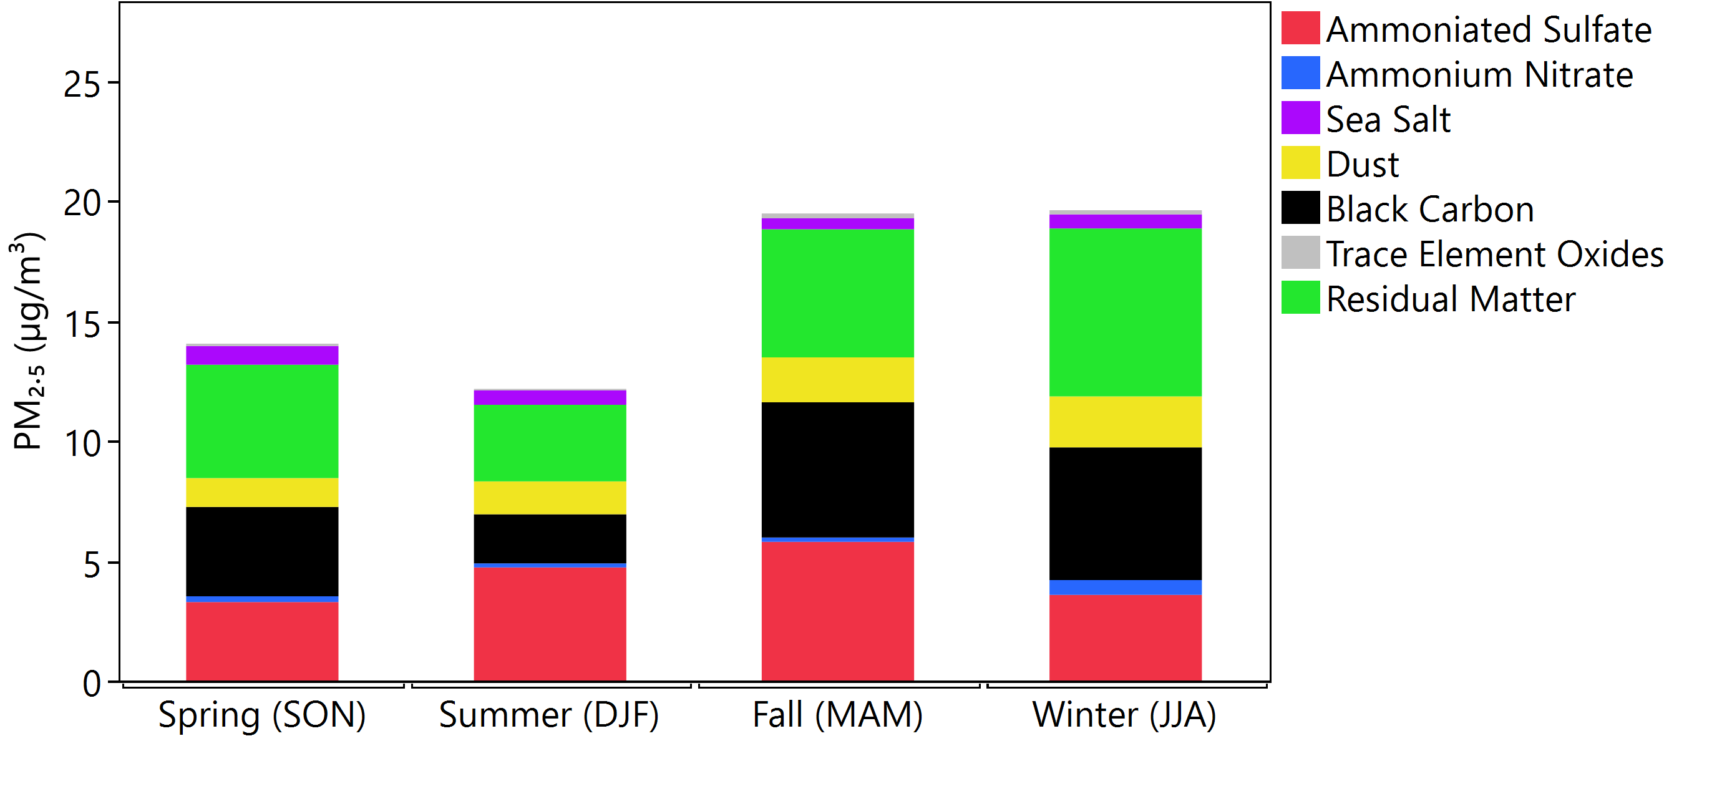
Preliminary Surface PM Monitoring Results in South Africa PTA
Seasonal Average PM_{2.5} Composition Measured by the SPARTAN Station in Pretoria (4/2021-2/2022)
Higher PM_{2.5} levels in fall and winter are also evident in the SPARTAN data.
Residual matter (representative of organic matter), black carbon, ammonium sulfate, and dust make up the majority of PM_{2.5} mass, respectively.
Ammonium nitrate accounts for only 2% of total PM_{2.5} mass.
Average black carbon concentrations range from 2 µg/m³ (~15% of total mass) in summer to 5.5 µg/m³ (~30% of total mass) in winter.

Slide 18
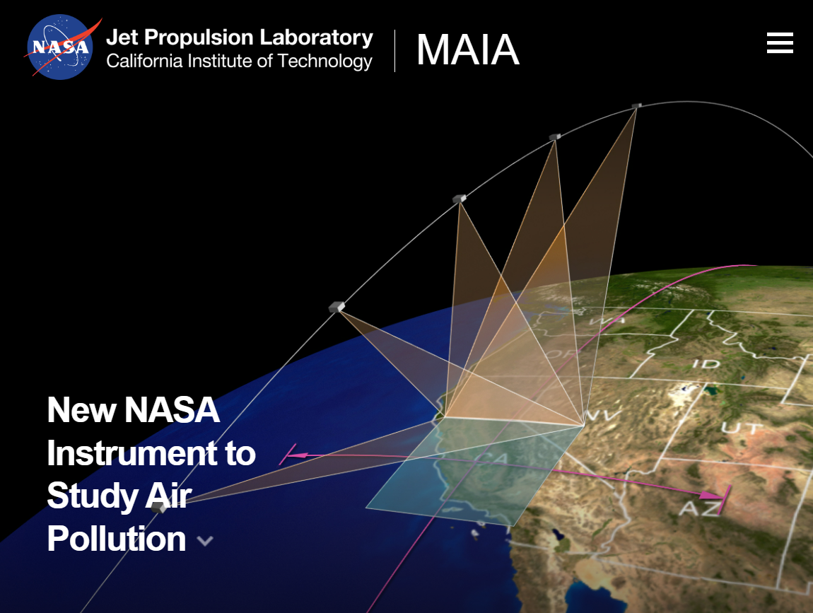
Summary
The MAIA satellite instrument will be launched next year (flight mission duration: 3 years), in partnership with the Italian Space Agency.
MAIA will generate daily maps of total PM_{2.5}, total PM₁₀, and speciated PM_{2.5} (sulfate, nitrate, EC, OC, dust) at 1-km spatial resolution in 11 primary target areas (PTAs).
Two PTAs are in Africa: Ethiopia (Addis Ababa and vicinity) and South Africa (Johannesburg and vicinity).
MAIA surface PM monitor deployments in the African PTAs are near completion and data are starting to be acquired.
MAIA-EVI data products will be publicly available at NASA’s Atmospheric Science Data Center.
Epidemiologists on the MAIA-EVI Science Team will investigate linkages between PM type and human health.
maia.jpl.nasa.gov
Sina.Hasheminassab@jpl.nasa.gov

Slide 19
Acknowledgments
The MAIA project is grateful to the field team members involved in the installation, operation, and maintenance of the air monitoring equipment, as well as those involved in laboratory analysis and data processing.
The US Agency for International Development (USAID) has provided funding to supplement MAIA's activities in Africa.
The US Department of State (USDOS) facilitates shipments of the air monitoring equipment and consumables. USDOS is also hosting some of the air monitoring equipment at the embassy sites.

